Slide 1
Consumer

Slide 2
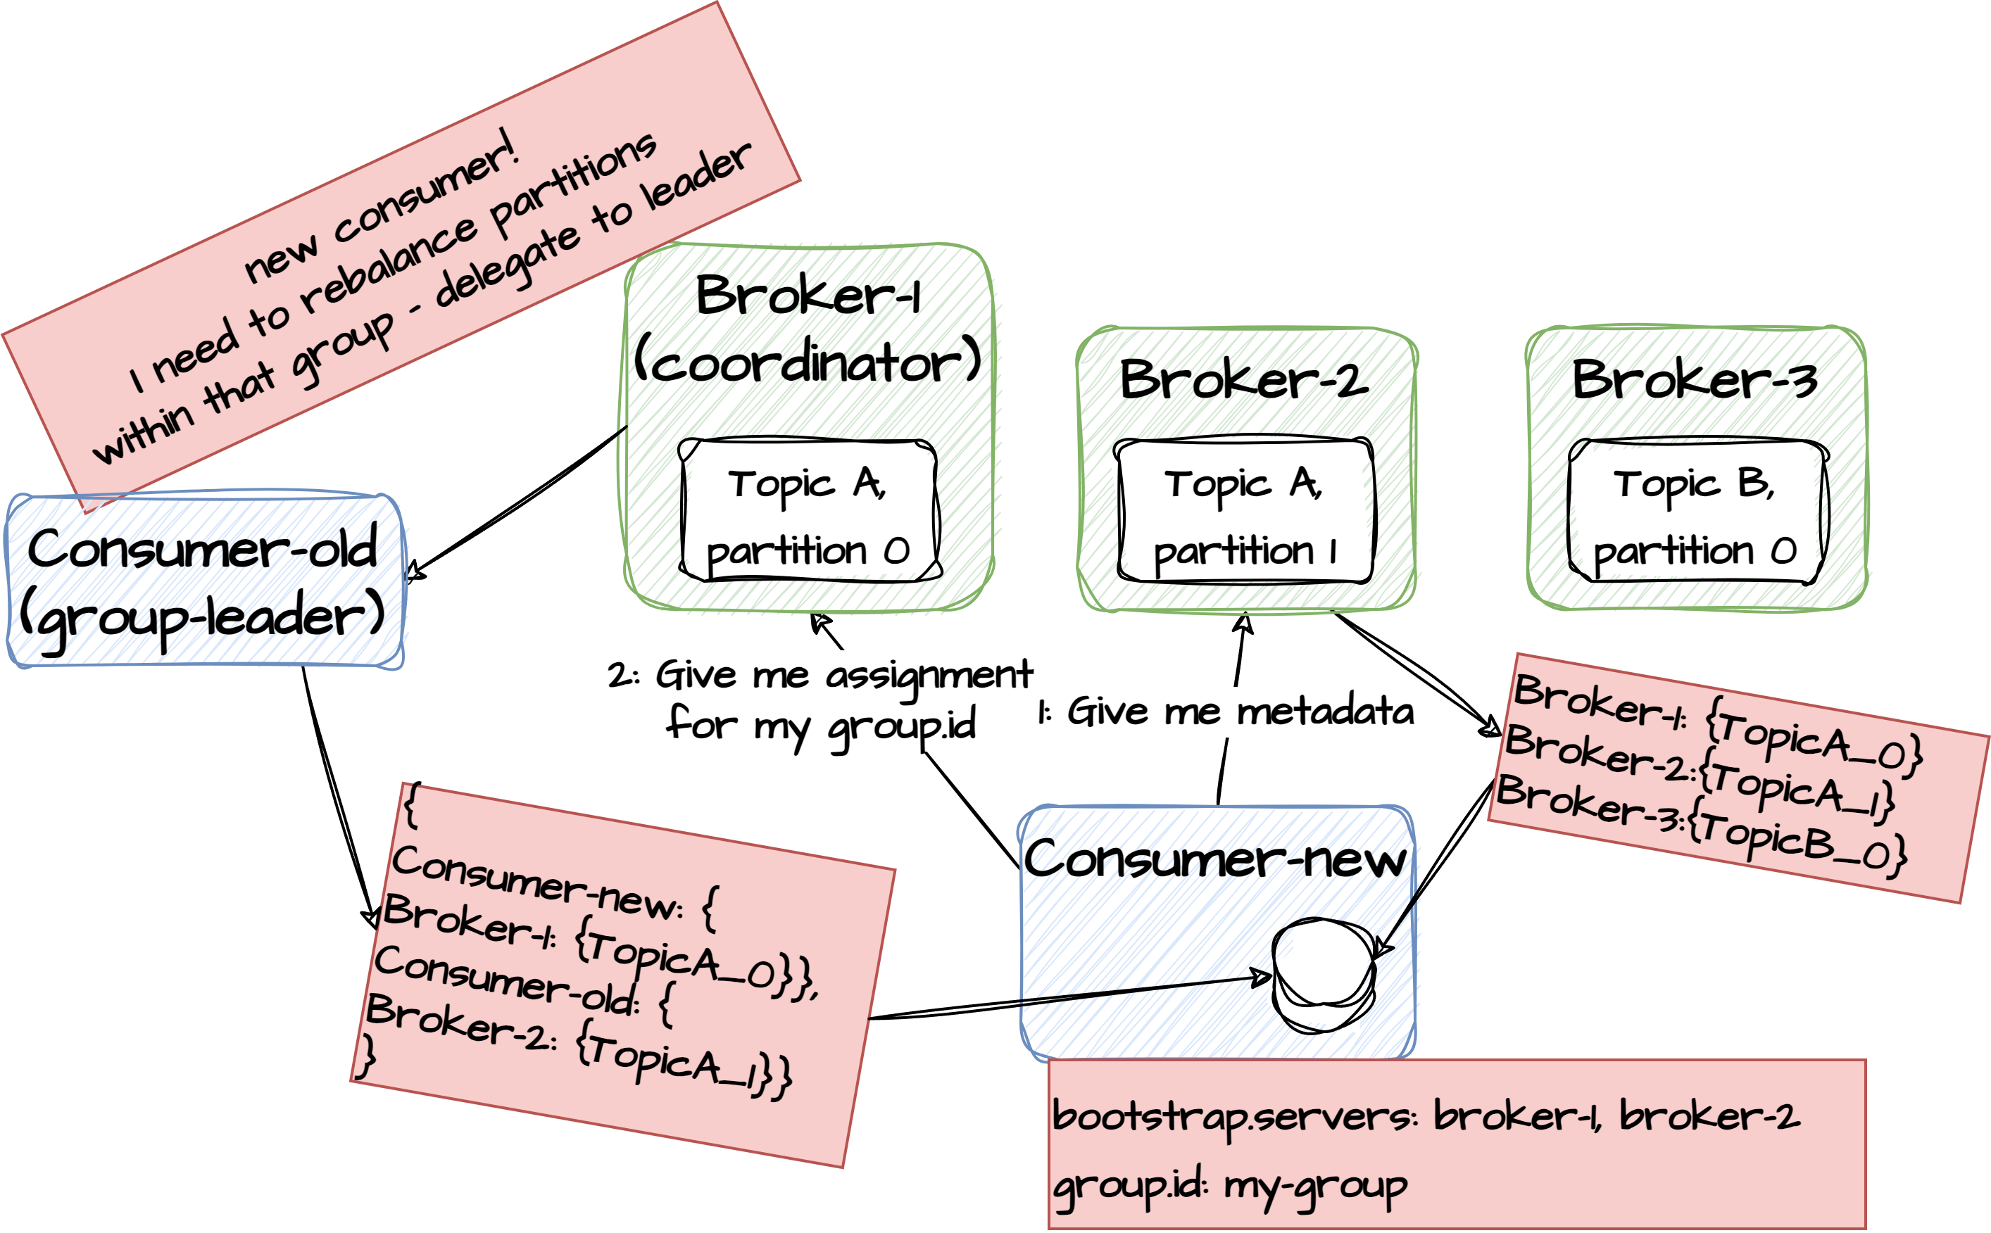
Bootstrapping
During initialization, the consumer must specify a bootstrap URL – a list of brokers in the cluster and potentially a consumer id, group id along with a deserialization class. One of the brokers in the bootstrap list is contacted and returns information of how partitions, leaders etc is distributed in the cluster. The consumer contacts the coordinator of the topics that it is interested in. The group coordinator+leader initiates a rebalancing process to distribute partitions evenly among the consumers. The consumer is informed about the partitions that it is assigned and what offset to consume from. This information is cached in the consumer and only renewed if a repartitioning event happens. With this bootstrap information in place, the consumer can target the right brokers when consuming messages.

Slide 3
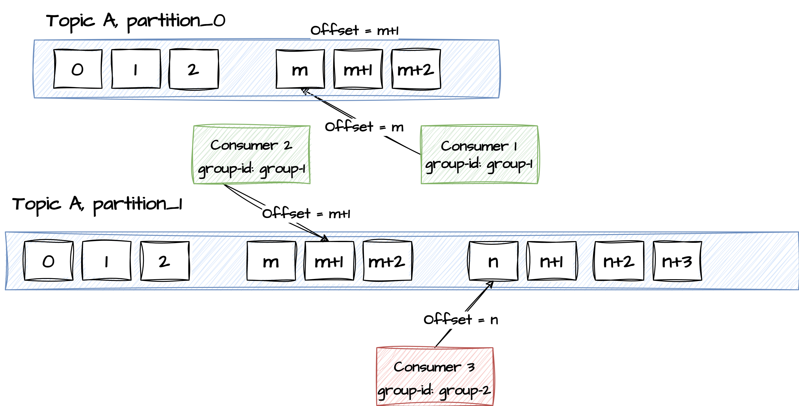
Consuming
After the bootstrapping process has completed, the consumer is now ready to consume from the partitions that it has been assigned to. If no offset was provided, the consumer starts from the tail of the log (The begin strategy can be controlled in the initialization property auto.offset.reset).
The consumer goes into an endless loop of polling the partitions it has been assigned for new records. When the consumer receives a batch of records it is told the last offset it has now consumed. This is the offset from where it will request the next batch.

Slide 4
Exercise
Create a consumer
Open PowerShell and navigate to <project-folder>/docker
Type .\kafka-consumer.bat --topic my-topic
Open a new PowerShell and navigate to <project-folder>/docker
Start a consumer and type string messages.
type .\kafka-producer.bat --topic my-topic
Go back to the consumer terminal and see that they were echoed there
6.1

Slide 5
Exercise
Create another consumer
Open PowerShell and navigate to <project-folder>/docker
Type .\kafka-consumer.bat --topic my-topic –from-beginning
This will start a new consumer for the same topic.
The consumer starts consumption from the beginning of the topic
In the producer terminal enter a few more messages and see that they are echoed in both producer terminal windows
6.2

Slide 6
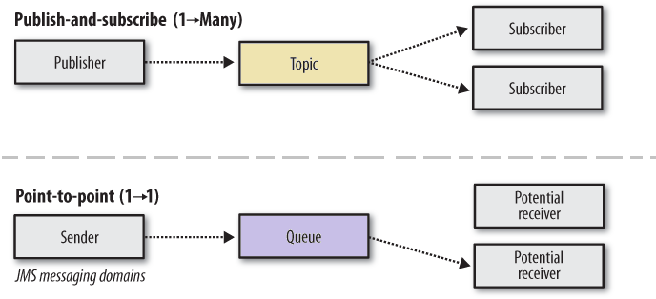
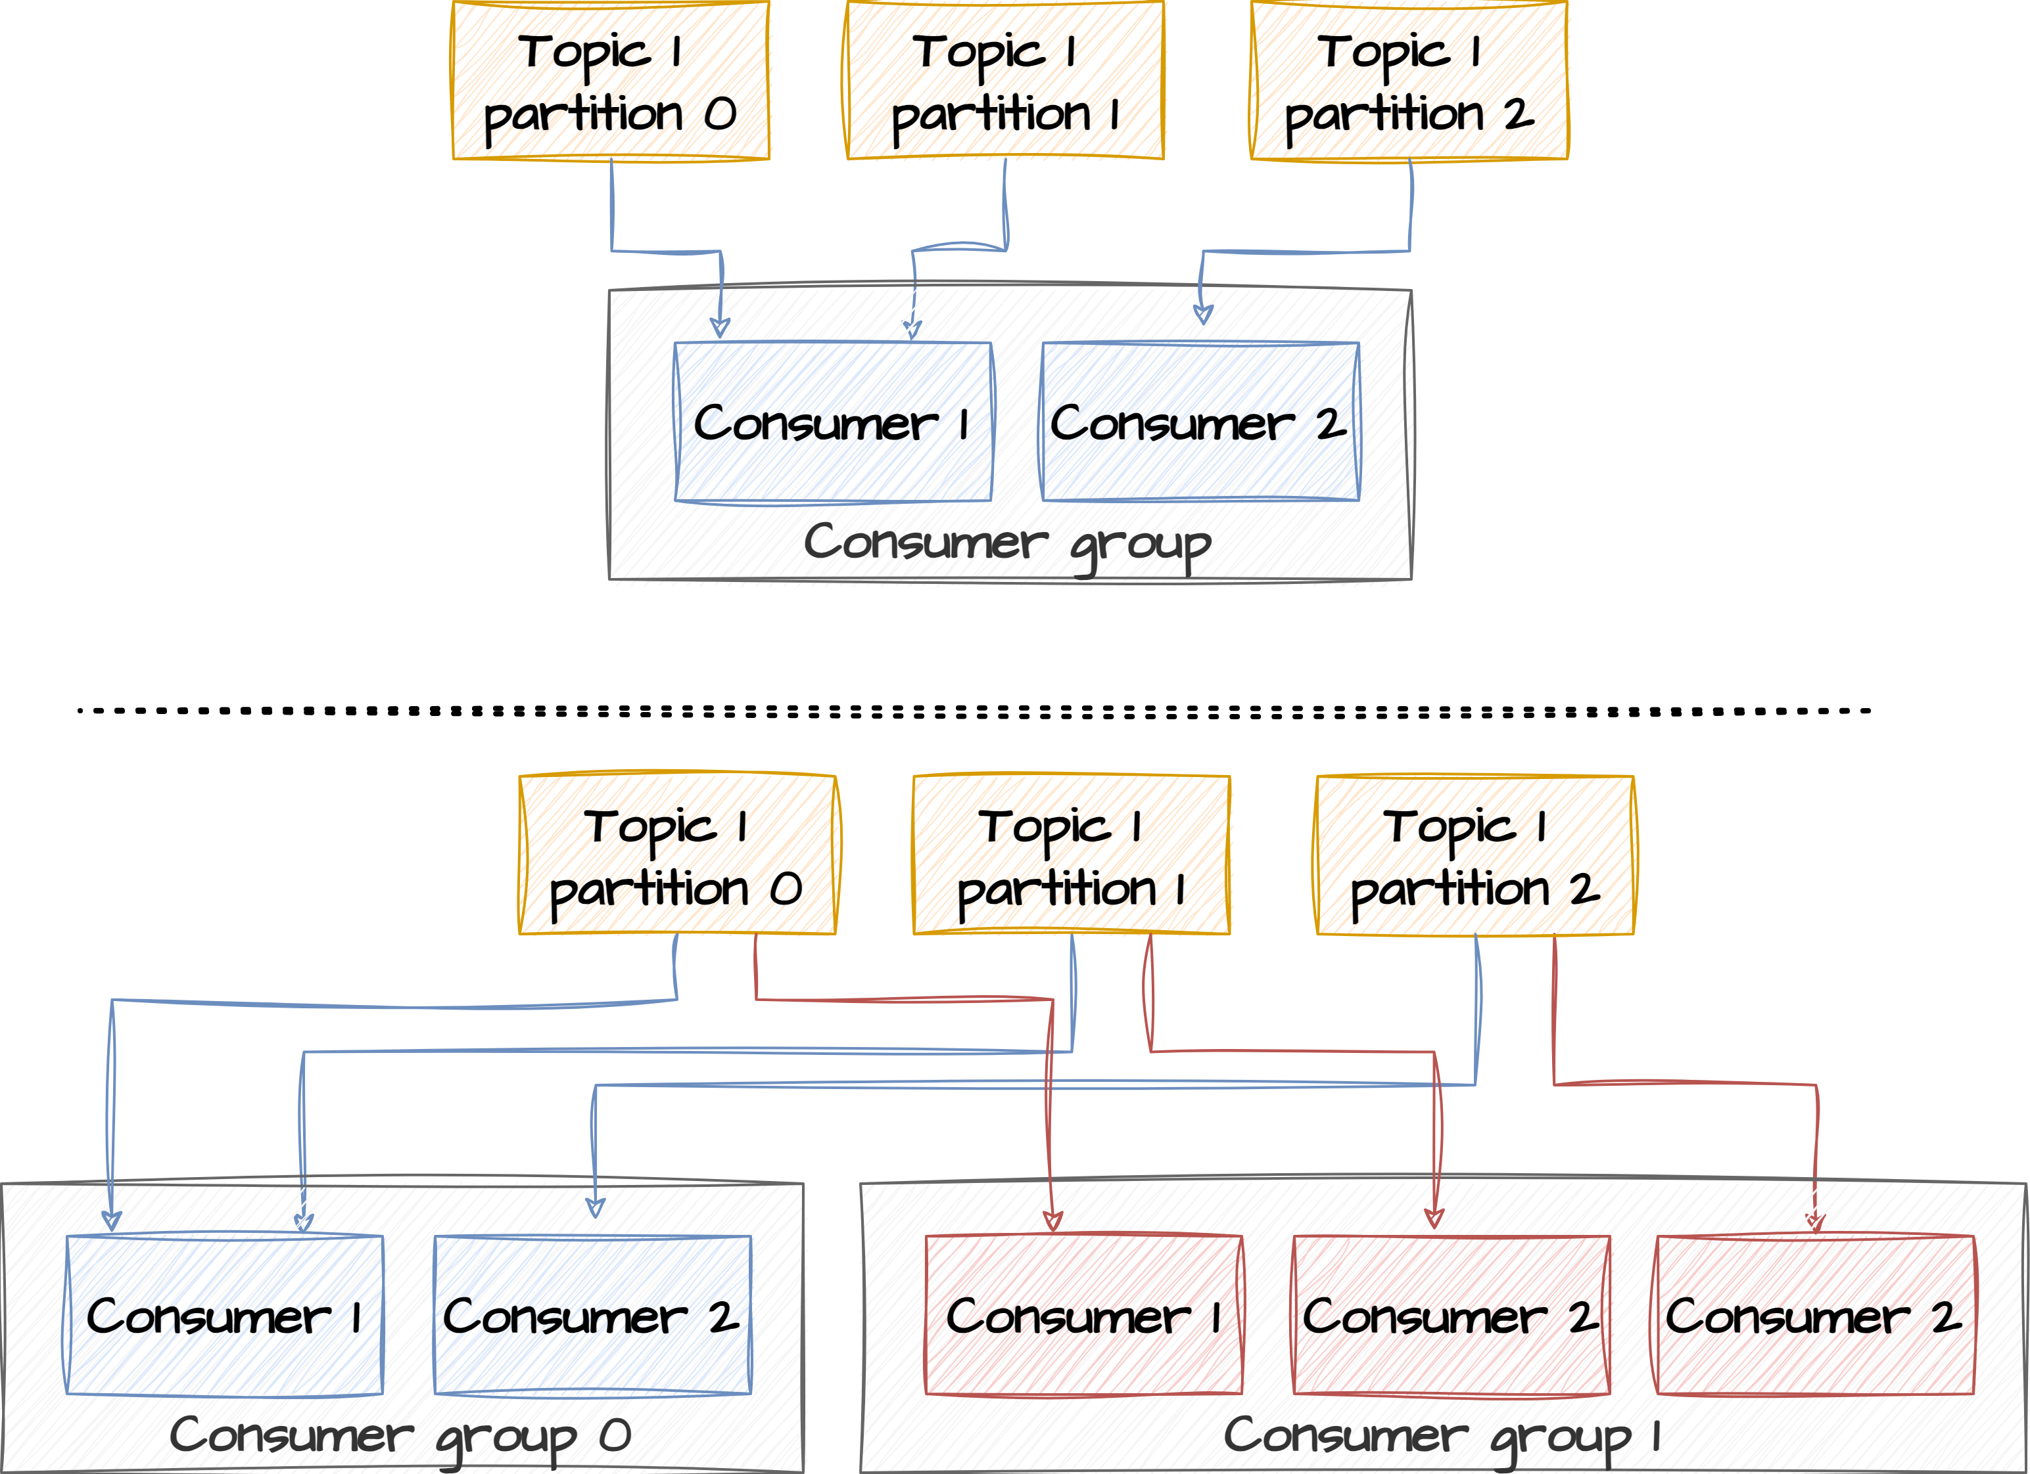
Consumer groups
Consumer groups allow you to parallelize the consumption of data, dividing the workload among multiple consumer instances. Each consumer within a group reads from a unique subset of partitions within a Kafka topic. This division ensures that each piece of data in a topic is processed by only one consumer within the group, maintaining consistency and load balancing. Consumers can join a group by using the same group.id.
Kafka assigns partitions to the consumers in the same group.
Each partition is consumed by exactly one consumer in the group.
Each consumer within a group reads from exclusive partitions.
One consumer can consume multiple partitions.
It cannot have more consumers than partitions. Otherwise, some consumers will be inactive state.
Queue or Topic?

Slide 7
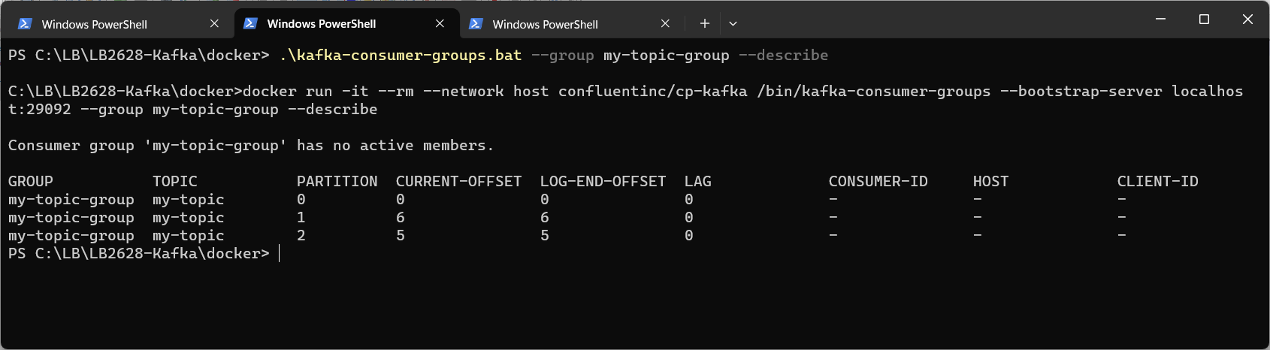
Exercise
Create consumer group
Open PowerShell and navigate to <project-folder>/docker
Type .\kafka-consumer.bat --topic my-topic --group my-group
Open PowerShell and navigate to <project-folder>/docker
Type .\kafka-consumer.bat --topic my-topic --group my-group
Open PowerShell and navigate to <project-folder>/docker
type .\kafka-producer.bat --topic my-topic)
Go back to the consumer terminal and see that they were echoed there. Note that messages are only processed by one consumer in the same group
Open PowerShell and navigate to <project-folder>/docker
Type .\kafka-consumer-groups.bat –list to see all consumer groups
Type .\kafka-consumer-groups.bat --group my-group –describe
You should see two consumers in that group
6.3

Slide 8
Exercise
Reset consumer group offsets
Open PowerShell and navigate to <project-folder>/docker
Type .\kafka-consumer.bat --group my-group --topic my-topic --from-beginning
A consumer with a consumer group is created
Open another PowerShell and navigate to <project-folder>/docker
Type .\kafka-producer-perf-test.bat --topic my-topic --num-records 100 --record-size 10 --throughput 10
A producer is producing a number of records to the topic
Open another PowerShell and navigate to <project-folder>/docker
Type .\kafka-consumer-groups.bat --group my-group –describe
You should see all the topics + partitions and its offsets for that group
Stop the consumer (else you get a warning when resetting)
Type .\kafka-consumer-groups.bat --group my-group --to-earliest --reset-offsets --execute --all-topics
This will reset all offsets in the consumer group back to earliest
Run the consumer group describe command again to see that offsets have been reset
Type .\kafka-consumer-groups.bat --group my-group --reset-offsets --shift-by 1 --execute --all-topics
Run the consumer group describe command again to see that offsets have been incremented
This is where new consumers in that group will pick up from when started
6.4

Slide 9
Consumer offset
Offset management in Apache Kafka allows consumers to keep track of which messages they have already consumed and ensures that they can resume processing from the correct position in the event of a restart or failure.
An offset is a unique identifier assigned to each message within a Kafka partition. It represents the position or sequence number of a message within the partition. Offsets start from 0 for the first message and increment by one for each subsequent message.
Consumer Offset:
Each Kafka consumer maintains its own offset for each partition it consumes. This offset indicates the next message that the consumer intends to read from a specific partition.
It is the responsibility of the consumer to keep track of and manage its own offsets.
Offset Committing:
Kafka consumers can commit their current offset to a Kafka topic (__consumer_offsets) or an external storage system. Committing an offset signifies that the consumer has successfully processed messages up to and including that offset.
Offset committing is essential for enabling consumers to resume processing from the last successfully consumed message, even if the consumer is restarted or replaced.
Offsets can be committed automatically or manually
Check it out in the topics
We don’t have to use Kafkas offset management

Slide 10
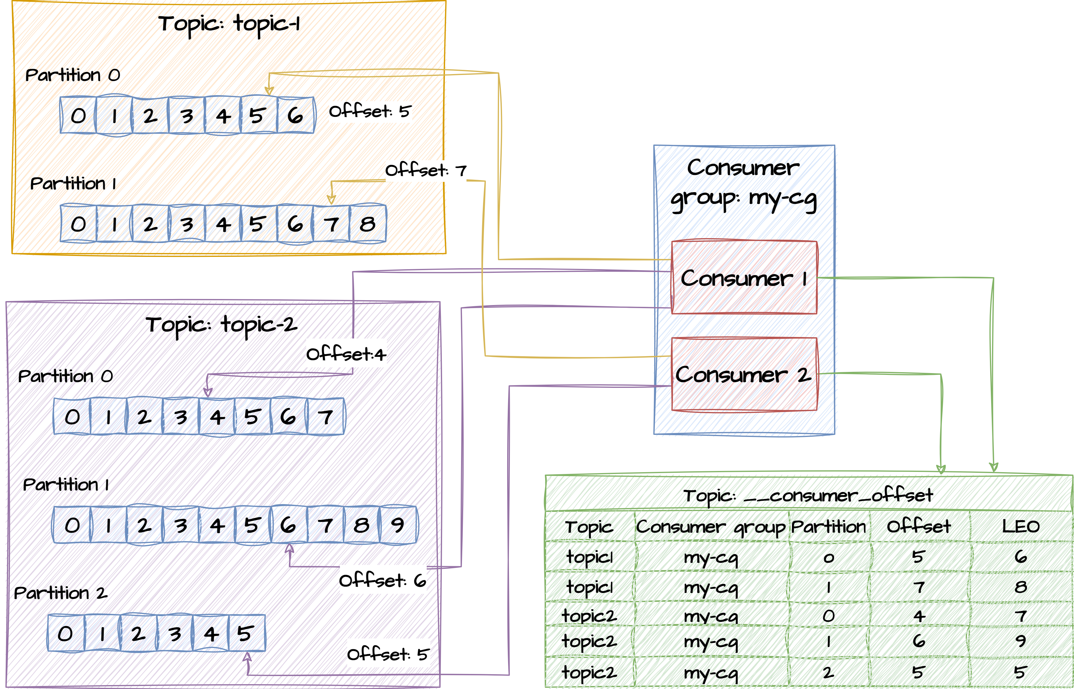
Consumer offset – using Kafka topic
Replicated across all nodes

Slide 11
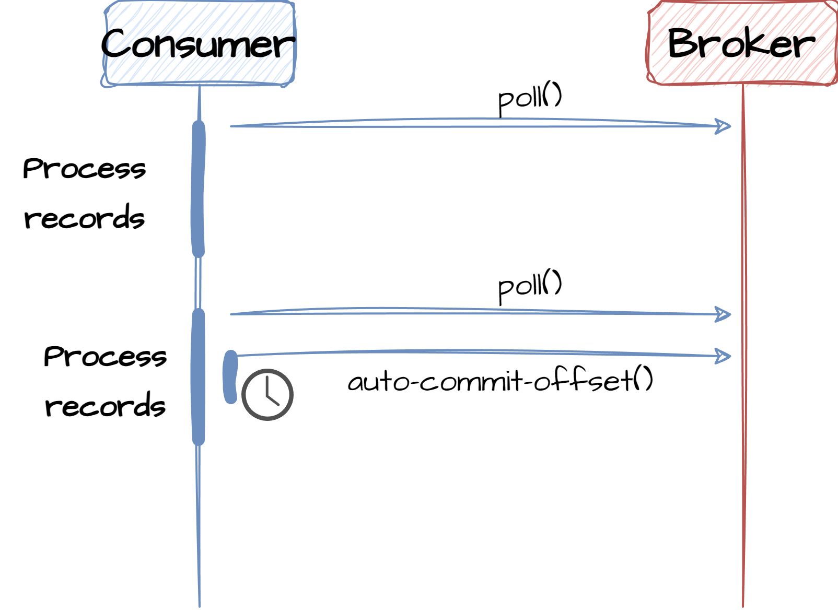
Auto-commit offsets
Auto-commit hands over the responsibility of committing offsets to the consumer. The consumer is configured to do auto committing using these properties:
enable.auto.commit, set to true to enable auto commit
auto.commit.interval.ms, defines the commit interval
When auto commit is enabled, the producer will commit the last consumed offset with a fixed frequency independent of the processing of the records.
The problem with this approach is that if the application fails to process some of the messages or crashes during processing, the auto-commit may already have committed the latest offset. This could cause a potential data loss. Not recommended in production

Slide 12
Consumer - auto commit
Properties props = new Properties();
props.put("enable.auto.commit", ”true");
props.put("auto.commit.interval.ms", ”5000");
try (KafkaConsumer<String, Supplier> consumer = new KafkaConsumer<>(props)) {
consumer.subscribe(Arrays.asList(topicName));
while (true) {
ConsumerRecords<String, Supplier> records = consumer.poll(100);
for (ConsumerRecord<String, Supplier> record : records) {
...
}
}
} catch (Exception ex) {
} finally {
consumer.close();
}
Auto-commit every 5 sec

Slide 13
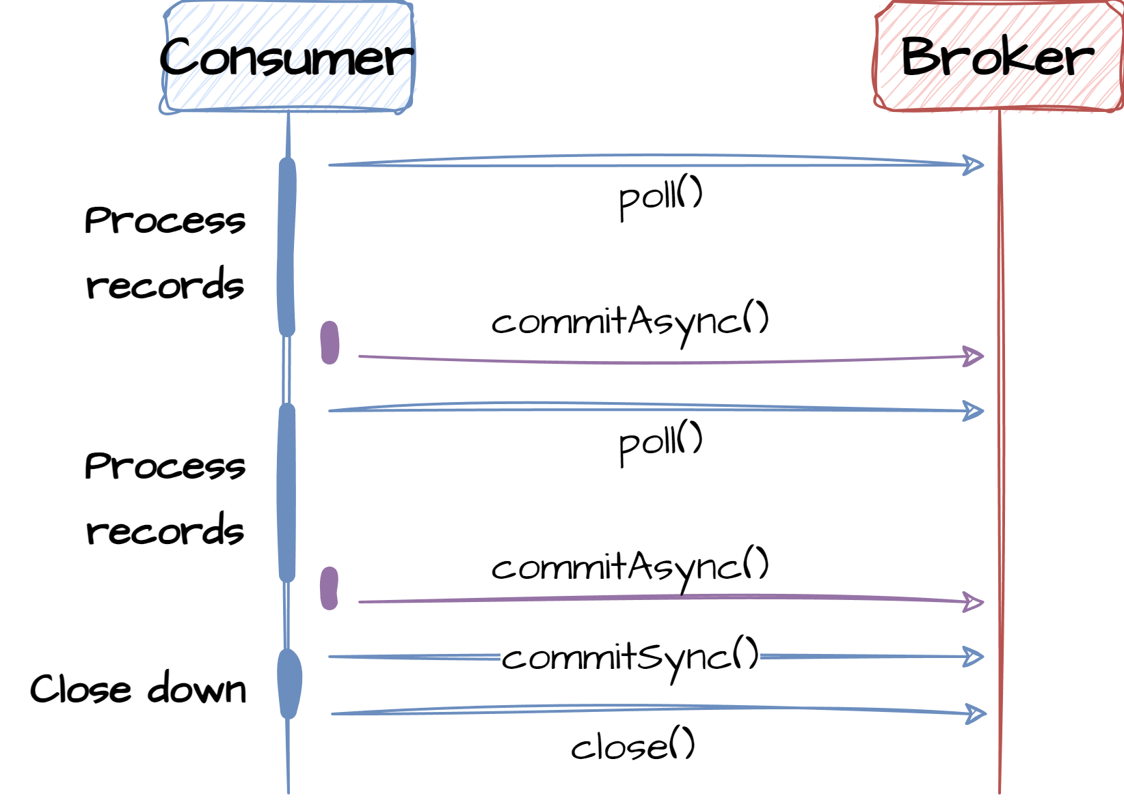
Manually commit offsets
Manually commit of offsets allows the application to control what offsets are communicated back to Kafka as committed. By setting enable.auto.commit to false, the consumer stops the periodic auto-commit process. There are two ways to do manual commit.
One is a synchronous call that blocks until the broker confirms that the offset has been committed and the other is an async call. The async has very little performance impact on the application but offers no guarantee of success/failure whereas the sync version offers high guarantee of success/failure with some performance impacts.
Typically, you would use a combination of the two when designing the offset commit strategy.
Be careful with the sync frequency (long processing latency) – the group coordinator may think the consumer is not responding!
Why is that a problem?

Slide 14
Consumer – manual commit
Properties props = new Properties();
props.put("enable.auto.commit", "false");
try (KafkaConsumer<String, Supplier> consumer = new KafkaConsumer<>(props)) {
consumer.subscribe(Arrays.asList(topicName));
while (true) {
ConsumerRecords<String, Supplier> records = consumer.poll(100);
for (ConsumerRecord<String, Supplier> record : records) {
...
}
consumer.commitAsync();
}
} catch (Exception ex) {
} finally {
consumer.commitSync();
consumer.close();
}
Non-blocking. No commit guarantee
Blocking. Guaranteed commit

Slide 15
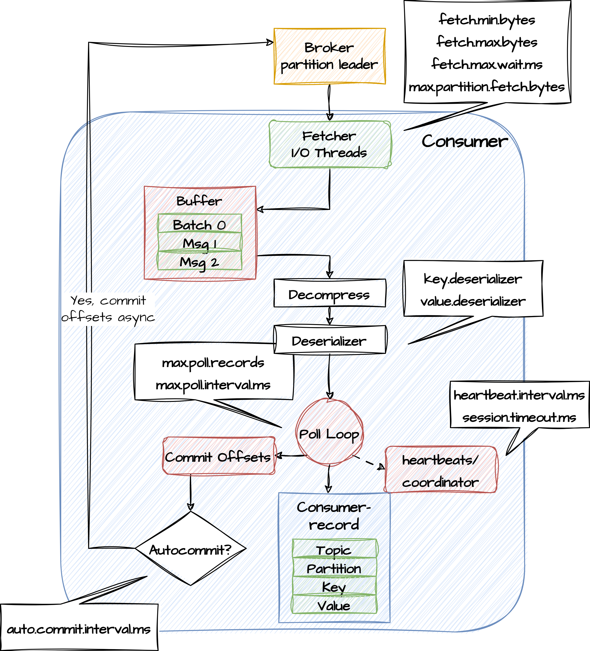
Consumer internal
Fetcher loads batches from the partition leaders and stores them in an in-memory buffer.
Poll loop requests a number of batches from the buffer. Batches are decompressed and deserialized
Poll loop checks if auto commit is enabled - if so, is it time to do an auto-commit call?
Heart beats are regularly sent to partition coordinator
Consumer records are passed to the consuming application.
Fetching decoupled from polling
Single threaded

Slide 16
Consumer – Parallel processing
ExecutorService executorService = Executors.newFixedThreadPool(5);
try (KafkaConsumer<String, Supplier> consumer = new KafkaConsumer<>(props)) {
consumer.subscribe(Arrays.asList(topicName));
while (true) {
ConsumerRecords<String, Supplier> records = consumer.poll(100);
for (ConsumerRecord<String, Supplier> record : records) {
executorService.submit(() -> {
processRecord(record);
}
}
}
}
} catch (Exception ex) {
} finally {}
What are the challenges here when processing in parallel?

Slide 17
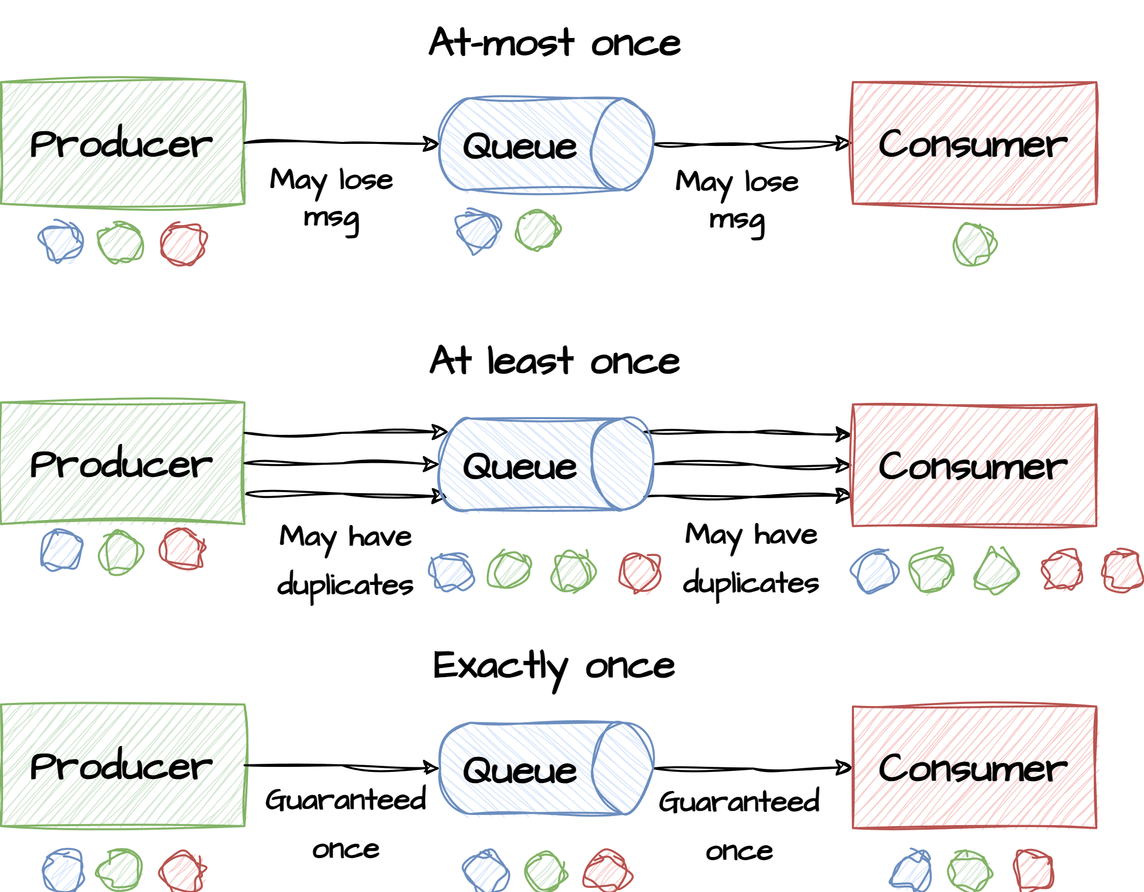
Consumer guarantee
At most once - Consumer reads a set of messages, saves its position in the log, and then processes the messages. If the consumer process crashes after saving its position, but before saving the output of its message processing, the consumer that takes over processing would start at the saved position and the messages prior to that position would not be processed.
At least once - This means a consumer reads a set of messages, processes them, and then saves its position. If the consumer process crashes after processing messages, but before saving its position, the new process that takes over may process some messages a second time.
Exactly once - When consuming from a Kafka topic and producing to another topic, Kafka leverages transactional producer capabilities. The consumer’s position is stored as a message in a topic, so offset data in written to Kafka in the same transaction as when processed data is written to the output topics.

Slide 18
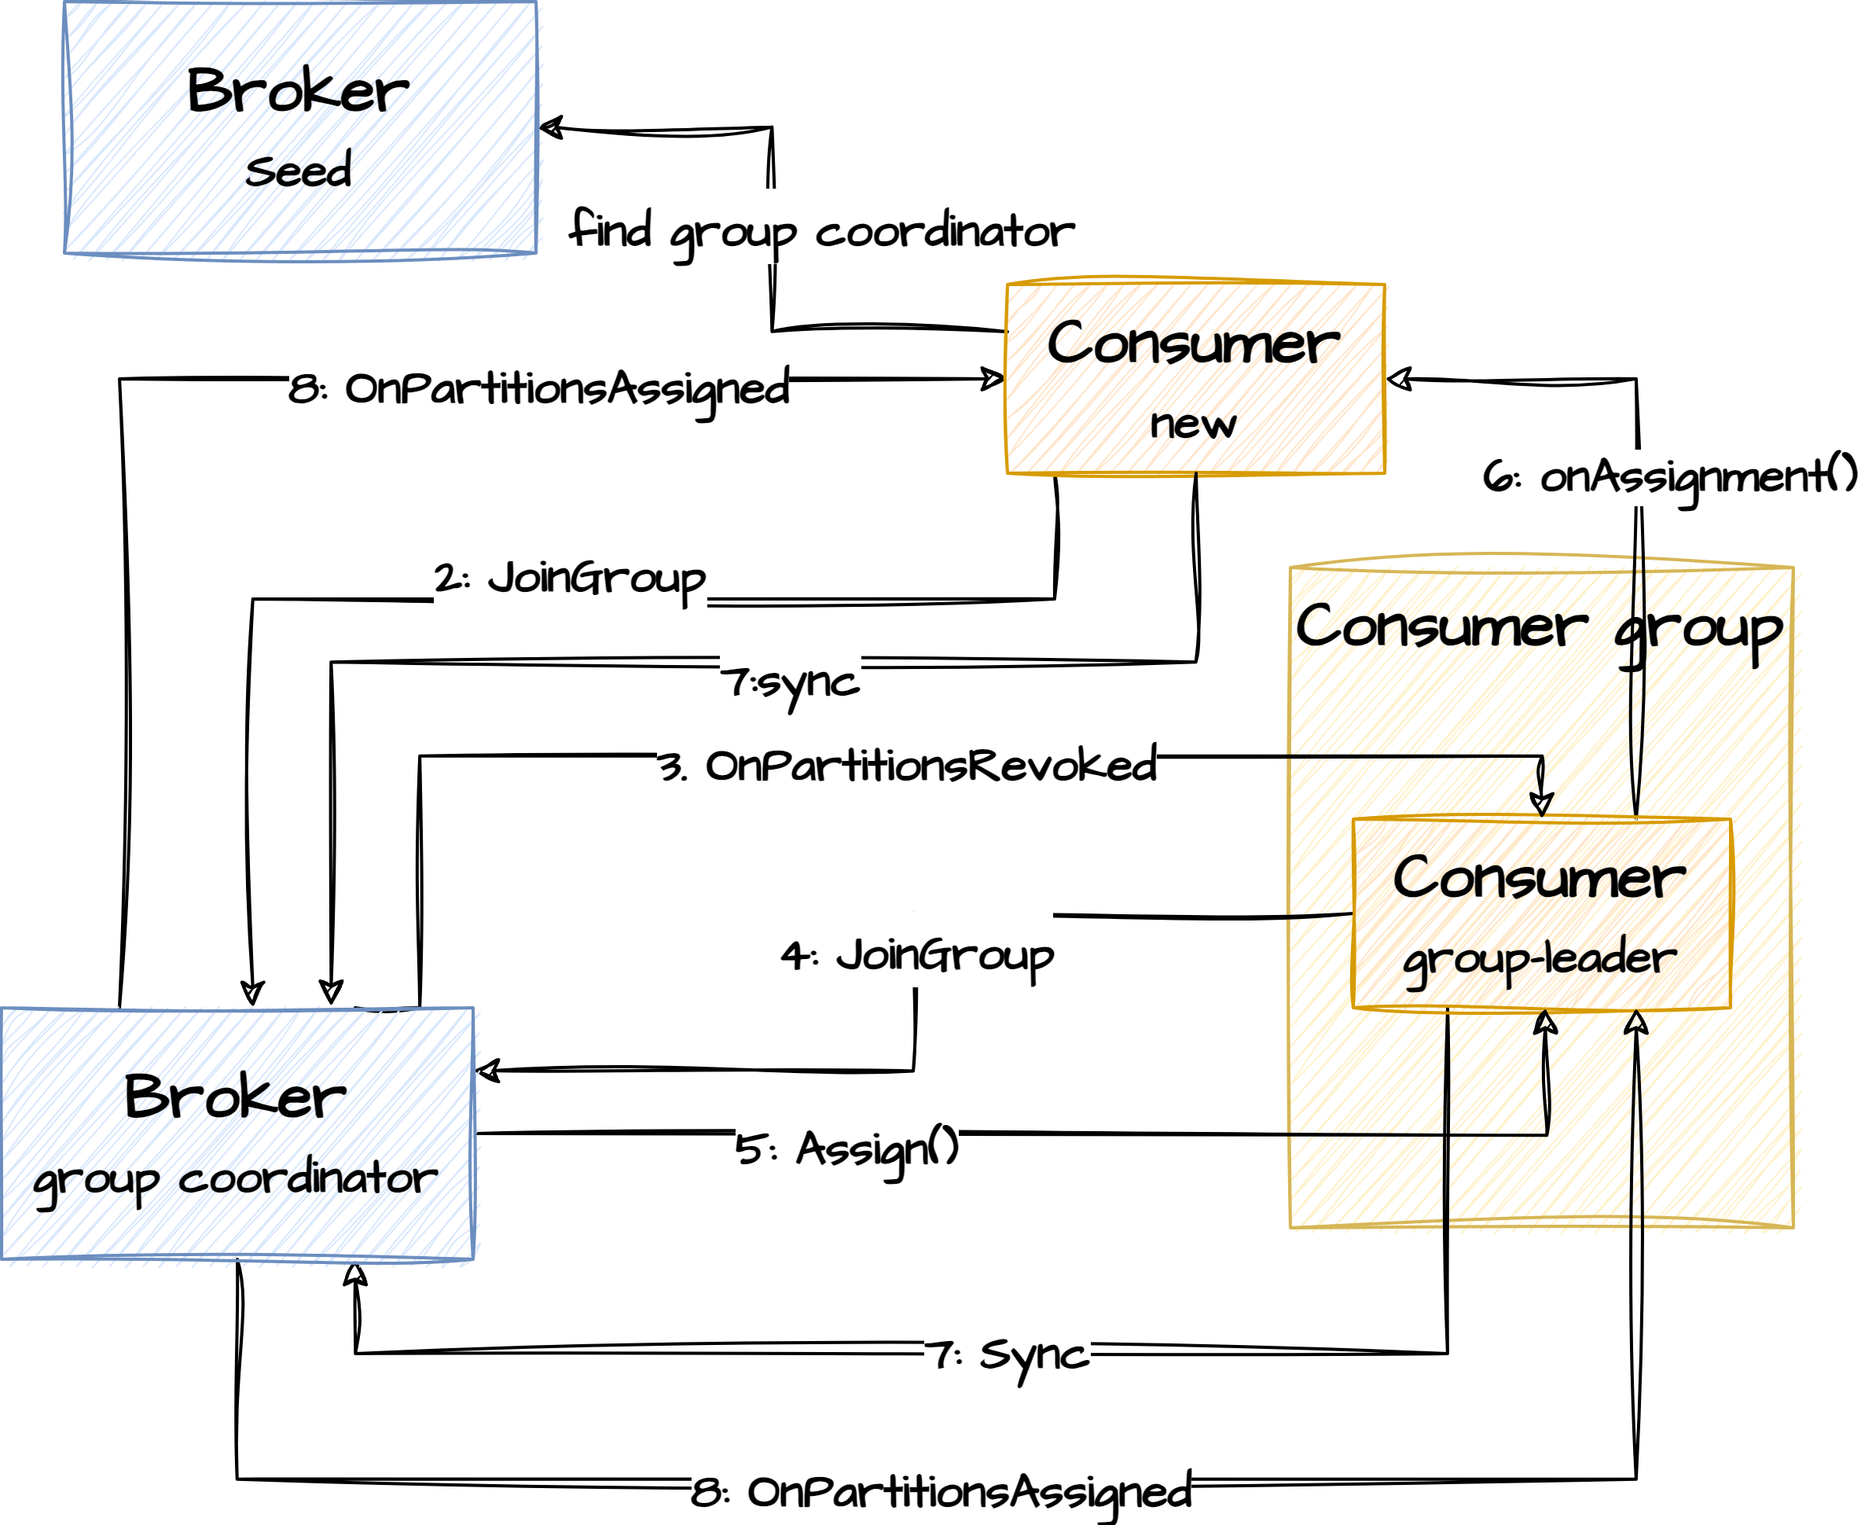
Rebalancing partitions
Reasons for a rebalancing partitions between consumers can be consumers leaving/joining the group or consumers stop sending heartbeats. It could also be new brokers leaving/joining the cluster.
The group coordinator is the broker which receives heartbeats(or polling for message) from all consumers within the consumer group and decides when to initiate rebalancing.
The group coordinator decides on a group leader (consumer) to do the partition assignment. Assignments get communicated to all other members in the group through the coordinator
Internally in the consumer, partition assignment is handled by a class implementing the PartitionAssignor interface
A callback interface ConsumerRebalanceListener is available for the application to be notified about the different steps in the repartitioning process
Why have both a coordinator and a leader?

Slide 19
Assigning partitions
The PartitionAssignor interface is used for internal communication between consumers when decisions on how partitions should be distributed must be made. This interface has callback methods for regular members and for the group leader that makes the assignment decision
Kafka provides several built-in partition assignors, such as the RangeAssignor and RoundRobinAssignor, which determine the rules for assigning partitions to consumers.
public interface PartitionAssignor {
// Callback on any member to get Subscription for all topics the consumer is interested in Subscription subscription(Set<String> topics);
// Invoked on the group leader to decide partitinon assignment pr member Map<String, Assignment> assign(Cluster metadata, Map<String, Subscription> subscriptions);
// Callback on all members to communicate what partitions have been assigned void onAssignment(Assignment assignment);
// Unique name of the consumer String name(); }

Slide 20
Rebalancing callback
The ConsumerRebalanceListener interface is used as a callback to the application. This allows the application to respond to rebalancing events before and after rebalancing happens. The below code persists its offsets to external storage and retrieves it again later
public class SaveOffsetsOnRebalance implements ConsumerRebalanceListener {
private Consumer<?,?> consumer;
public SaveOffsetsOnRebalance(Consumer<?,?> consumer) {
this.consumer = consumer;
}
public void onPartitionsRevoked(Collection<TopicPartition> partitions) {
// save the offsets in an external store using some custom code not described here
for(TopicPartition partition: partitions) {
saveOffsetInExternalStore(consumer.position(partition));
}
}
public void onPartitionsAssigned(Collection<TopicPartition> partitions) {
// read the offsets from an external store using some custom code not described here
for(TopicPartition partition: partitions) {
consumer.seek(partition, readOffsetFromExternalStore(partition));
}
}
}

Slide 21
Exercise
Partition reassignment
Open PowerShell and navigate to <project-folder>/docker
Type .\kafka-consumer.bat --group my-group --topic my-topic --from-beginning
Open another PowerShell and navigate to <project-folder>/docker
Type .\kafka-consumer-groups.bat --group my-group –describe
See what partitions have been assigned to what clients
Open another PowerShell and navigate to <project-folder>/docker
Type .\kafka-consumer.bat --group my-group --topic my-topic --from-beginning
Type .\kafka-consumer-groups.bat --group my-group –describe
See that partitions have been reassigned
6.5

Slide 22
Consumer configuration
fetch.min.bytes
The minimum amount of data the server should return for a fetch request. If insufficient data is available the request will wait for that much data to accumulate before answering the request. The default setting of 1 byte means that fetch requests are answered as soon as that many byte(s) of data is available or the fetch request times out waiting for data to arrive.
group.id
A unique string that identifies the consumer group this consumer belongs to. This property is required if the consumer uses either the group management functionality by using subscribe(topic) or the Kafka-based offset management strategy.
session.timeout.ms
The timeout used to detect client failures when using Kafka’s group management facility. The client sends periodic heartbeats to indicate its liveness to the broker. If no heartbeats are received by the broker before the expiration of this session timeout, then the broker will remove this client from the group and initiate a rebalance. Note that the value must be in the allowable range as configured in the broker configuration by group.min.session.timeout.ms and group.max.session.timeout.ms.

Slide 23
Consumer configuration
allow.auto.create.topics
Allow automatic topic creation on the broker when subscribing to or assigning a topic. A topic being subscribed to will be automatically created only if the broker allows for it using auto.create.topics.enable broker configuration.
auto.offset.reset
What to do when there is no initial offset in Kafka or if the current offset does not exist any more on the server (e.g. because that data has been deleted):
earliest: automatically reset the offset to the earliest offset
latest: automatically reset the offset to the latest offset
none: throw exception to the consumer if no previous offset is found for the consumer’s group anything else: throw exception to the consumer.
enable.auto.commit
If true the consumer’s offset will be periodically committed in the background.

Slide 24
Consumer configuration
fetch.max.bytes
The maximum amount of data the server should return for a fetch request. Records are fetched in batches by the consumer, and if the first record batch in the first non-empty partition of the fetch is larger than this value, the record batch will still be returned to ensure that the consumer can make progress. As such, this is not a absolute maximum. The maximum record batch size accepted by the broker is defined via message.max.bytes (broker config) or max.message.bytes (topic config). Note that the consumer performs multiple fetches in parallel.
max.poll.interval.ms
The maximum delay between invocations of poll() when using consumer group management. This places an upper bound on the amount of time that the consumer can be idle before fetching more records. If poll() is not called before expiration of this timeout, then the consumer is considered failed and the group will rebalance in order to reassign the partitions to another member. For consumers using a non-null group.instance.id which reach this timeout, partitions will not be immediately reassigned. Instead, the consumer will stop sending heartbeats and partitions will be reassigned after expiration of session.timeout.ms. This mirrors the behavior of a static consumer which has shutdown.

Slide 25
Consumer configuration
max.poll.records
The maximum number of records returned in a single call to poll(). Note, that max.poll.records does not impact the underlying fetching behavior. The consumer will cache the records from each fetch request and returns them incrementally from each poll.
partition.assignment.strategy
A list of class names or class types, ordered by preference, of supported partition assignment strategies that the client will use to distribute partition ownership amongst consumer instances when group management is used. Available options are:
RangeAssignor: Assigns partitions on a per-topic basis.
RoundRobinAssignor: Assigns partitions to consumers in a round-robin fashion.
StickyAssignor: Guarantees an assignment that is maximally balanced while preserving as many existing partition assignments as possible.
CooperativeStickyAssignor: Follows the same StickyAssignor logic, but allows for cooperative rebalancing.

